Slide 1
Whitley County Community Corrections
The Indiana State Legislature passed the Community Corrections Act in 1980, which encouraged local counties to develop sentencing alternatives. At this time, many prisons were overcrowded and local jails were getting paid to house prisoners for the State.
The ordinance to establish a Community Corrections Program in Whitley County was signed in July of 1990. Programming included Home Detention and Community Service supervision. Over the years stakeholders have expanded services to respond to local needs.
Established July 1, 1990

Slide 2
Mission: To provide a multi-facet community-based program that facilitates behavioral change by incorporating the effective use of evidence-based practices through cognitive change programs, aimed to increase motivation and cease criminal thinking prior to their incorporation back into the community, enhancing public safety.
Whitley county community corrections

Slide 3
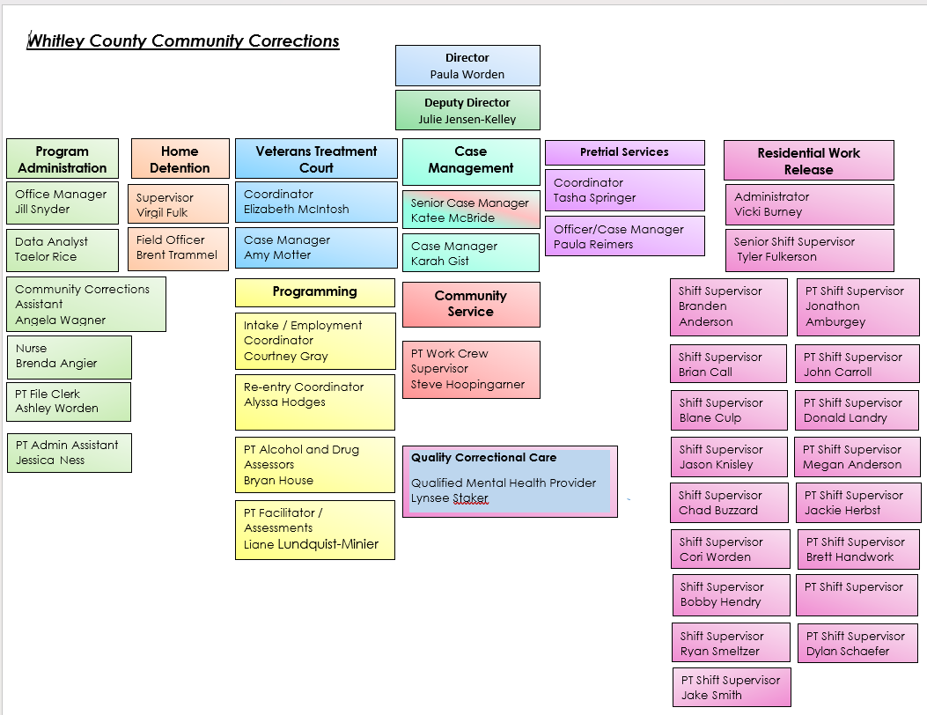

Slide 4
Advisory Board Members
Greggory Hockemeyer, Chairperson Ed Beber Anthony Churchward John Barrett
Judge Matthew Rentschler, Vice Chairperson Michael Schrader Jennifer Reiff Carolyn Ross
Mista Lauber, Secretary Bob Lotter Sharon Persons Theresa Baysinger
D.J. Sigler, Jr. Lindsey Grossnickle Kurt Lehman Jennifer Christie
Senior Judge James Heuer Gary Parrett Elizabeth Deckard Nancy Prickett
Judge Douglas Fahl Jason Spencer Sara Herendeen April Waugh

Slide 5
Organizational Chart

Slide 6
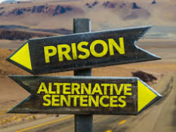
Home Detention/Residential Services Adult Referrals
 | Cases
Home Detention | 78
F4 | 1
F5 | 9
F6 | 50
FA | 1
MA | 9
MB | 4
MC | 2
NC | 2
Re-Entry Residential Program | 7
F4 | 1
F5 | 2
F6 | 4
Residential Work Release | 180
F2 | 3
F3 | 5
F4 | 14
F5 | 25
F6 | 112
MA | 16
NC | 5
Residential Work Release - Electronic Monitoring | 1
MA | 1
Transitional Living | 14
F3 | 1
F4 | 1
F5 | 1
F6 | 8
MA | 2
MB | 1
Grand Total | 280
2024
A total of 17,690 executed days were served under these two levels of supervision. If this time would have been served in jail or prison it would cost taxpayers approximately $930,670 this does not include the medical cost savings.

Slide 7
Certified Alcohol and Drug Program
Number of participants in each of the following categories:
 |  |  |  |  | Substance Abuse Information: | 0
 |  |  |  |  | Basic Substance Abuse Education: | 50
 |  |  |  |  | Advanced Substance Abuse Education: | 06
 |  |  |  |  | Substance Abuse Treatment: | 129
 |  |  |  |  | Self-Help: | 5
 |  |  |  |  | No Referral: | 0
Program provides multiple services to address the needs of those individuals struggling with substance and /or substance-related issues. The purpose is to teach participants to stop the cycle of abusing substances and committing crimes. All services are determined by Professional Staff that have been certified by the Indiana Judicial Center. All referrals are Court ordered.

Slide 8
Certified Pretrial Services Program
The goal of bail setting is to maximize release while simultaneously maximizing court appearance and public safety. Effective pretrial justice systems utilize risk-based decision-making to release or detain defendants while maintaining public safety and high levels of court appearance.
98.12% of defendants supervised by Pretrial Services completed supervision with no Failure to Appears.
94.57% of defendants supervised by Pretrial Services completed supervision win no new offenses.
2024 Referrals
463 misdemeanor cases
268 felony cases
Notes:
Whitley County Pretrial Services Program:

Slide 9
Supervising Judge: Honorable Douglas Fahl (currently on military deployment)
Supervising Judge: Honorable Antony Garza
Veterans Treatment Court Coordinator: Elizabeth McIntosh
Veterans Treatment Court Case Manager: Amy Motter
Team Members:
Rita Wynn, Veterans Justice Outreach, VA Northern Indiana Healthcare Systems, Joshua Smith, Veterans Service Officer, Jennifer Patrick, Chief Deputy Prosecutor, Lindsey Grossnickle, Deputy Prosecutor, Haley Scribner, Deputy Prosecutor, Elizabeth Deckard, Public Defender, Nathan Lundy, Public Defender, Julie Jensen-Kelley, Community Corrections Deputy Director, Edward Beber, Chief Probation Officer, Brent Trammel, Field Officer, Jonathon Stoffel, Law Enforcement Officer, Mista Lauber, Executive Director Bowen Health, Scott Valentic, Recovery Support Specialist, Allendale Treatment Center, and Brittney Schori, Health and Human Sciences Educator, Whitley County Purdue Extension.
Veterans Treatment Court provides an alternative to those that have served our country who also are combating substance abuse and mental health issues. The program supports local law enforcement by providing substance abuse services to those who have been arrested/convicted of drug/alcohol offenses or committed offenses that while under the influence of substances. Graduation ceremonies took place on May 30, 2024, and November 7, 2024, to celebrate the success of 7 graduating veterans. Future ceremonies are scheduled for May 22, 2025 and November 13, 2025.
Certified Veterans Treatment Court Program
In 2024, a total of 34 veterans participated in the Whitley County Veterans Treatment Court program (32 males & 2 females). As of this report, there are currently 25 Veterans Treatment Court participants in the program. 6 are transfer-ins from Kosciusko County, 2 are transfer-ins from Huntington County, 1 is a transfer in from Wells County, and 12 are Whitley County cases. We also currently have 1 participant transferred out to St. Joseph County Veterans Treatment Court, 1 transferred out to Lake County Veterans Treatment Court, 1 transferred out to Marion County Veterans Treatment Court, and 1 transferred out to LaPorte County Veterans Treatment Court. There are currently 7 individuals with pending cases that have been given information about the VTC program. One of those referrals has been screened, and will possibly be a transfer to Kosciusko County Drug Court, due to transportation limitations. To date, there have been 58 successful completions, 11 terminations, and 6 withdrawals. The Whitley County Veterans Treatment Court currently has a graduation rate of 77% and a retention rate of 83%.

Slide 10
Community Corrections Local JRAC/Advisory Board
The Community Corrections Advisory Board and Local JRAC continue to work with community partners to identify gaps is services. This collaboration has allowed for additional mental health services. Bowen Health now offers after hours on-call services for adults in Whitley County. Credentialed staff are available to provide crisis response care to residents of Whitley County. The Board will continue to work on expanding housing opportunities and other re-entry services for those being released from incarceration.
Governor Holcomb signed House Enrolled Act 1068 into law on April 8, 2021 (effective July 1, 2021), establishing a local Justice Reinvestment Advisory Council (Local JRAC) in each county [IC 33-38-9.5-4]. Local JRACs are required to promote the use of evidence-based and best practices in the areas of community-based sentencing alternatives and recidivism reduction; review, evaluate, and make recommendations about local practices (community-based corrections and jail overcrowding); compile reports as directed by the State JRAC; and communicate with the State JRAC to establish and implement best practices and to ensure consistent collection and reporting of data. The Whitley County Community Corrections Advisory Board also serves as the local JRAC.

Slide 11
Programs facilitated by Community Corrections and Probation staff.
Alcohol and Drug Program Education Programs: Julie Jensen-Kelley, Community Corrections Deputy Director and Bryan House, Community Corrections Program Facilitator
Moral Reconation Therapy (MRT): Ian Desch, Probation Officer
Domestic Violence Therapy (DVT): Ian Desch, Probation Officer
Relapse Prevention: Julie Jensen-Kelley, Community Corrections Deputy Director
Seeking Safety: Liane Lundquist-Minier, Program Facilitator
Trauma MRT: Karah Gist, Community Corrections Case Manager
Matrix: Liane Lundquist-Minier, Program Facilitator

Slide 12
Quality Correctional Care Residential Services
Residential Work Release Participants
Intake assessments
Programming referrals
Individual counseling services
Mental health educational classes Lynsee Staker, Qualified Mental Health Provider
Re-entry/JCAP Participants
Intake assessments
Individual counseling services
Group and individual skills
Relapse prevention
Case management
MRT programming
Anger Management programming

Slide 13
Residential JCAP/Re-entry Services
Residential/JCAP is a 4 month evidence-based program made up of 6-8 hours of classes daily. The classes are divided into two sections, with 50% of the curriculum covering mental health and recovery and the other 50% focusing on life skills. The program also offers High School Equivalency tutoring for those who need it. Program offers NO time cuts or ANY guarantee of sentence modification. The primary goal of the program is to focus on recovery. Participants are held to a higher standard of behavior and required to give 100% participation in all classes. If one is not invested in their recovery, they will be removed from the program.
To be eligible for the program the following must be met; history of drug or alcohol abuse, a projected release date that qualifies participants to complete the program, not sentenced to DOC, court approval that reads as follows: Defendant is sentenced to the Whitley County Jail with no objection to that sentence being served at the Whitley County Community Corrections Residential Facility. Jail conduct is also considered in the selection process.
Re-entry programs provide a wide range of services including job training, housing assistance, health care, and substance abuse education/treatment. Re-entry programs are essential for ensuring the successful reintegration of individuals being released from prison, jail, or residential work release.
The mission of these programs is to provide incarcerated individuals with the resources and support needed to gain confidence in their ability to live sober, productive lives through the rehabilitation programs, counseling, life skills, and effective communication

Slide 14
Residential Facility Wellness Services Brenda Angier, NP-C, RN
Meet with participants in need of medical care or questions pertaining to their health and well-being. (Illnesses, injuries, B/P checks, diabetic care, wound care, ear washing, etc.)
Triaging participants to provide proper medical facilities if in need of medical attention.
Maintain participant charts.
Verify and approve medical passes for participants.
Work with each participant in need of medical insurance. Assist participants in applying for Medicaid if eligible.
Schedule appointments with primary care providers, dental providers, and vision care for participants.
Mentor participants.
Complete medical intake on all new incoming participants.
Review medications
TB skin testing/recording results on all new participants.
Set up medications with an outside pharmacy (Genoa) if needed.
Prepare for weekly classes with JCAP when in session.
Medication reconciliation and report
Facilitate outside speakers/health care providers (Positive Resources) for education/testing for the participants.
Facilitate educational classes for participants.
TB Clinic/Testing
.

Slide 15
Community Corrections Transitional Housing
Community based supervision program participants may apply to participate in this level of service. Transitional housing provides stability, support and connection to resources in order to become self-sufficient. In exchange for a weekly fee participants will receive a bed, informal case management, housing resources and access to employment services. Participants must be drug and alcohol free and must comply with drug and alcohol testing. When in the facility all residential work release rules apply including curfews. A participants stay is limited to 6 months.
In 2024, 14 individuals participated in this level of service. The average length of stay was 52 days.
In addition, agency continues to partner with Mission 25 to provide housing opportunities to eligible participants in the community.

Slide 16
Employment Readiness Program
This level of service offers employment search strategies.
Networking
Proper job search appearance and attire.
How to complete employment application including how do disclose criminal history.
Resume building/maintenance; build individual resumes for participants to take with them.
Interview skills; including conviction response and mock interviews.
Employment retention skills; performance, communication, conflict in workplace.
Educate participants on Work Opportunity Tax Credits (WOTC) and Fidelity Bond information; including ways to market themselves in their job search.
Participants must submit a job search plan for approval.
At the end of each week participants turn in their daily plan with outcomes recorded.
Staff maintain accountability and verify productivity via, participant calls while job seeking, random surveillance in the community and follow up calls to employers.
Staff share information regarding actively hiring businesses, maintain a list of felon friendly businesses, and make referrals.
Computers and phones are available for participants to complete on-line applications and make follow-up calls.

Slide 17
Whitko Career Academy
In 2024 program participants had the opportunity to participate in CNC,
Culinary Arts, Welding and Business classes. Most of the cost are funded
by a grant awarded to the Whitley County Community Foundation.
Whitley County Drug-Free Indiana also awarded funds for graduation supplies and tuition. If a participant fails to complete the class, they are charged $400.00.

Slide 18
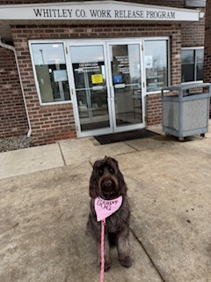
Support Dog Journey
Handlers: Amy Motter and Julie Jensen-Kelley
To maintain certification Alliance Therapy requires Handlers to volunteer their time visiting locations with Journey. This year Handlers volunteered their time visiting schools, senior housing, Whitley County Council on Aging, and the residential work release facility. In addition, Journey worked approximately 360 hours attending case management meetings, residential work release activities, and programming.
Total expenses for 2024 were $1,722.18 of that $331.59 was paid by a grant and the balance was paid by the Handlers.

Slide 19
Community Service Program Impact
Total Agencies Served: 55
Number of Hours Completed: 10,153
Total Value: $73,607.00
Court ordered community service is a sentencing alternative that allows offenders to give something back to the community. Provides assistance to non-for-profit and governmental agencies. The Community Service Work crew operates Monday-Thursday.

Slide 20
Jail Services
The Indiana Department of Correction awarded $24,000.00 for fiscal year 2024. Funding was to provide an additional seven hours of mental health services to inmates in the Whitley County Jail. These (7) seven hours are added to the (6) six hours that are included in the Whitley County Jail Inmate-Healthcare contract making a total of thirteen (13) hours per week of on-site mental health services. Services are provided by Quality Correction Care (QCC) which is certified by the Division of Mental Health and Addictions. The Community Corrections Data Analyst is required to submit quarterly data to the Indiana Department Correction on the following Performance Outcomes: Percentage of inmates reported being seen by mental health provider within 7 days of intake after reporting a history of mental health. Percentage of inmates that reported satisfaction with mental health services on jail exit survey. Percentage of inmates that reported they received information on Medication Assisted Treatment on jail exit survey. Percentage of inmates that reported they received a community resource guide on jail exit survey.

Slide 21
2024 Financial Information
Community Corrections received approximately $1,300,000.00 in grants for fiscal year 2024.
Operating budget was approximately $2,500,000.00. This does not include utilities or other building expenses supported by county maintenance.
County Commissioners and Council approved $615,00.00 in ARPA funds for facility renovations.
The program continues to assess and collect user fees. However, referrals for services that generate daily fees continue to decrease. Therefore, other funding sources are needed to sustain current operations.

Slide 22
Project Income User Fee Fund Process
The Indiana Department of Correction Grant Agreement requires a separate fund be established for Project income and identified as the "Community Corrections Project Income Fund." Expenditures from this fund shall be accounted for in the same manner as all other expenditures of Community Corrections grant money. User fees and other funds collected by Project components funded under this Grant Agreement shall be included in the Community Corrections Project Income Fund unless the collection and maintenance of those funds is mandated elsewhere under Indiana Code, including but not limited to probation user fees collected under Indiana Code 35-38-2-1 et seq.
Grantee agrees to establish and maintain within the agency responsible for program implementation a daily ledger in such form as approved by the State Board of Accounts. Said daily ledger shall include receipts, expenditures and balances by category and line item corresponding to the budget of the approved application for funds.
Whitley County Community Corrections Project Income includes: participant user fees, participant commissary purchases, Drug-free Indiana awards, bank interest, and commission.

Slide 23
2024 Project Income User Fee
Fee Summary
Fee | Amount
Alcohol & Drug Case Management Fee | $3,384.00
Alcohol & Drug Program Assessment | $200.00
Assessment/Case Management/Education (In House) | $31,201.00
Assessment/Case Management/Referral Out | $29,360.00
Cell Phone Fine | $100.00
Commissary | $59,200.00
Commission | $51,735.75
Community Corrections Bank Account Interest | $4.17
Community Service Initial Fee | $22,873.00
Component Weekly Advance | $150.00
Domestic Violence MRT Fee | $25.00
Drug Testing Fee | $16,277.00
Home Detention Daily Fee | $87,444.25
Juvenile Home Detention Fee | $1,619.00
Laundry Fee | $95.00
MRT Transfer In Case | $450.00
MRT Workbook | $550.00
Pretrial Services Fee | $32,004.00
Re-Entry Services Fee | $5,016.00
Seeking Safety Class Fee | $100.00
TB Test | $35.00
TRAC Fee | $1,892.00
Transfer Case Management Fee | $9,500.00
Transitional Living Fee | $14,948.50
Veterans Court Intake Fee | $2,100.00
Veterans Court Transfer Fee | $340.00
Veterans Court Weekly Drug Testing Fee | $9,363.00
Work Release Daily Fee | $480,725.82
Work Release Differential Fee | $148.57
Grand Total | $860,841.06
Whitley County Community Corrections Project Income Fund

Slide 24
Project Income Fund Commissary Procedure
All Commissary payments are receipted in the SRS database and deposited daily in Star Financial Bank. The Director reconciles the bank account monthly. A Report of Collections is prepared for the Whitley County Auditor, and all funds collected monthly are deposited with the Whitley County Treasurer and receipted into Project Income.
Commissary funds may be used to restock commissary inventory, luncheon meetings, in-service training, participant incentives; cable, recreation activities, and program supplies/equipment.
All invoices for Commissary purchases are submitted to the Director. The Director uploads all invoices in the LOW financial database for the County Auditor to authorize payments to be processed through the Project Income Fund Commissary line item.
Participants are not allowed to bring in hygiene or food items; they must purchase items through commissary.
Participants will pay cash for their purchases. Payments are processed through the participant’s SRS Commissary Financial Account.
All commissary items will be priced with a minimum of a 20% increase over actual cost; rounded to the nearest dollar. Cost and pricing of all commissary items are regularly reviewed and adjusted as needed. Changes in commissary items and pricing must be approved by the Director.

Slide 25
Project Income Vendor Commission
HomeWAV, LLC : participant telephone/video calls. Department receives 40% commission check monthly for usage.
2024 Revenue: $19,511.51
Snyder’s Food Service: Department receives a monthly electronic commission payment for sales.
2024 Revenue: $14,988.97

Slide 26
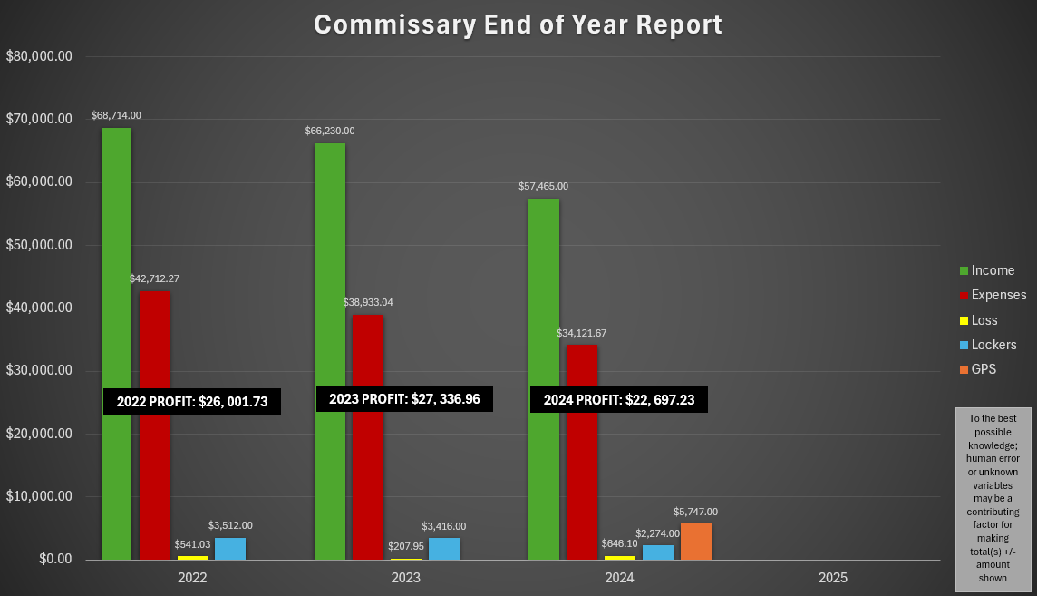
Facility Commissary Report
Notes:
Chad Buzzard
Residential Shift Supervisor

Slide 27
Community Corrections 2024 Review
Over the past 34 years I have been blessed to work with and for so many amazing people. This community is well known for its ability to collaborate and work through difficult times.
Much appreciation to all of you for the great work that you do for our community.
Some goals I have for 2025 are as follows:
Create “job handover guides” for all full-time Community Corrections positions. This was a suggestion made during a weekly case management meeting by staff.
Work with Whitley County Government Leaders and the Advisory Community Corrections Board to develop a Financial Sustainability Plan.
Develop a Re-entry model.
Serve on the Addiction Recovery Court Team.
Continue to serve on the Whitley County Community Foundation, TROY School, YMCA Board, and the Indiana Association of Act Counties Executive Committee.
Serve on the County Personnel Committee.
Respectfully,
Paula Worden

