Slide 1
Whitley County Community Corrections 2023 Review
Established July 1, 1990

Slide 2
Mission: To provide a multi-facet community-based program that facilitates behavioral change by incorporating the effective use of evidence-based practices through cognitive change programs, aimed to increase motivation and cease criminal thinking prior to their incorporation back into the community, enhancing public safety.
Whitley county community corrections

Slide 3
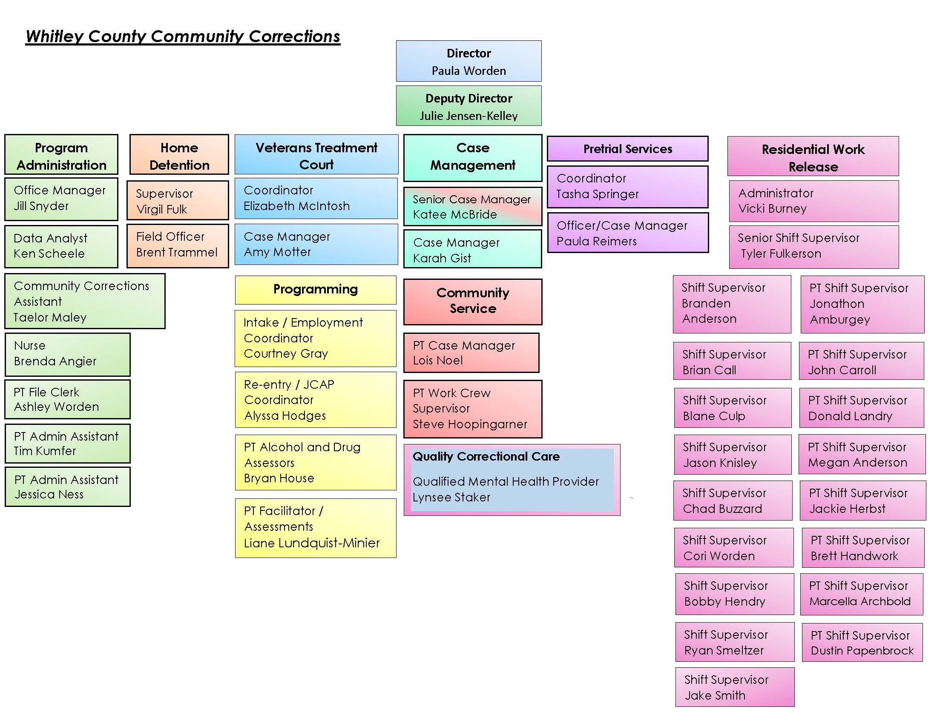

Slide 4
Advisory Board Members
Greggory Hockemeyer, Chairperson Ed Beber Anthony Churchward John Barrett
Judge Matthew Rentschler, Vice Chairperson Michael Schrader Jennifer Reiff Carolyn Ross
Mista Lauber, Secretary Bob Lotter Sharon Persons Theresa Baysinger
D.J. Sigler, Jr. Lindsey Grossnickle Kurt Lehman Ian Desch
Senior Judge James Heuer Gary Parrett Elizabeth Deckard Nancy Prickett
Judge Douglas Fahl Jason Spencer Amanda Herendeen

Slide 5
Organizational Chart

Slide 6
2023 Adult Referrals Home Detention/Residential Services

Slide 7
Alcohol and Drug Program
Number of participants in each of the following categories:
 |  |  |  |  | Substance Abuse Information: | 0
 |  |  |  |  | Basic Substance Abuse Education: | 40
 |  |  |  |  | Advanced Substance Abuse Education: | 12
 |  |  |  |  | Substance Abuse Treatment: | 93
 |  |  |  |  | Self-Help: | 4
 |  |  |  |  | No Referral: | 0
Program provides multiple services as a means to address the needs of those individuals struggling with substance and /or substance-related issues. The purpose is to teach participants to stop the cycle of abusing substances and committing crimes. All services are determined by Professional Staff that have been certified by the Indiana Judicial Center. All referrals are Court ordered.

Slide 8
Pretrial Services
The goal of bail setting is to maximize release while simultaneously maximizing court appearance and public safety. Effective pretrial justice systems utilize risk-based decision-making to release or detain defendants while maintaining public safety and high levels of court appearance.

Slide 9
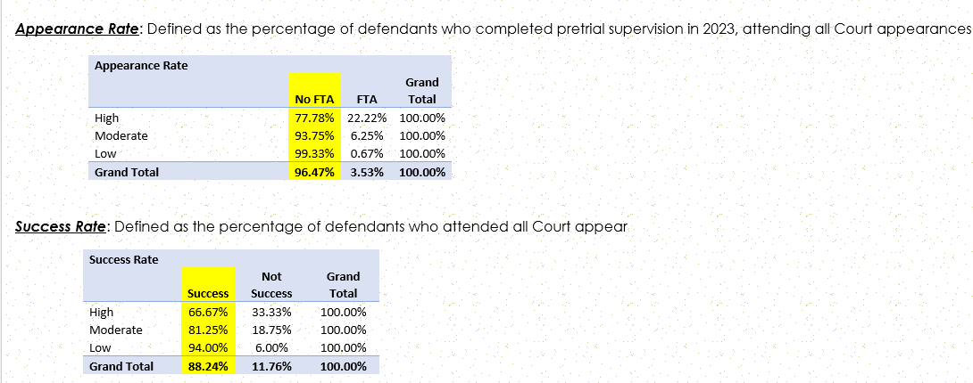
Pretrial Services continued

Slide 10
Veterans Treatment Court
In 2023, a total of 25 veterans participated in the program (23 males & 2 females). As of today, there are currently 14 veterans in the program (2 are transferred out to other counties). There are 7 pending referrals, and 3 individuals have been officially accepted into the program are awaiting their Change of Plea Hearings. To date, there have been 52 successful completions, 8 terminations, and 5 withdrawals. In 2023, graduation ceremonies were held for 10 veterans. The Whitley County Veterans Treatment Court program currently has a graduation rate of 83% and a retention rate of 86%.
The Whitley County Veterans Treatment Court program began preparation in 2014 for the implementation of a Problem- Solving Court in Whitley County. he Veterans Treatment Court is designed to reduce re-arrests, promote self-sufficiency through employment and education and to help you remain in the community as a productive and responsible member of society by diversion from prison or jail. The Veterans Treatment Court program is voluntary. Participants must be motivated to make changes and commit to a totally drug free life.

Slide 11
Community Corrections Local JRAC/Advisory Board
Local JRACs are required to promote the use of evidence-based and best practices in the areas of community-based sentencing alternatives and recidivism reduction; review, evaluate, and make recommendations about local practices (community-based corrections and jail overcrowding); compile reports as directed by the State JRAC; and communicate with the State JRAC to establish and implement best practices and to ensure consistent collection and reporting of data. The Whitley County Community Corrections Advisory Board also serves as the local JRAC. The Board continues work to determine gaps in services. Staff uses the Sequential Intercept Model as a tool to assist Board in developing plan for community change.
Governor Holcomb signed House Enrolled Act 1068 into law on April 8, 2021 (effective July 1, 2021), establishing a local Justice Reinvestment Advisory Council (Local JRAC) in each county [IC 33-38-9.5-4].

Slide 12
THE SEQUENTIAL INTERCEPT MODEL
The Sequential Intercept Model (SIM) was developed over several years in the early 2000s by Mark Munetz, MD, and Patricia A. Griffin, PhD, along with Henry J. Steadman, PhD, of Policy Research Associates, Inc. (PRA). The SIM was developed as a conceptual model to inform community-based responses to the involvement of people with mental and substance use disorders in the criminal justice system. After years of refinement and testing, several versions of the model emerged. The “linear” depiction of the model found in this publication was first conceptualized by Dr. Steadman of PRA in 20041 through his leadership of a National Institute of Mental Health-funded Small Business Innovative Research grant awarded to PRA. The linear SIM model was first published by PRA in 20052 through its contract to operate the GAINS Center on behalf of the Substance Abuse and Mental Health Services Administration (SAMHSA). The “filter” and “revolving door” versions of the model were formally introduced in a 2006 article in the peer-reviewed journal Psychiatric Services authored by Drs. Munetz and Griffin.3 A full history of the development of the SIM can be found in the book The Sequential Intercept Model and Criminal Justice: Promoting Community Alternatives for Individuals with Serious Mental Illness.

Slide 13
Community Partners
~Programming~

Slide 14
Programs: Anything structured and curriculum based for participants to participate in. Facilitated by Community Corrections and Probation staff.
Alcohol and Drug Program Education Programs: Julie Jensen-Kelley, Community Corrections Deputy Director and Bryan House, Community Corrections Program Facilitator
Moral Reconation Therapy (MRT): Ian Desch, Probation Officer
Domestic Violence Therapy (DVT): Ian Desch, Probation Officer
Relapse Prevention: Julie Jensen-Kelley, Community Corrections Deputy Director
Seeking Safety: Liane Lundquist-Minier, Program Facilitator
Trauma MRT: Karah Gist, Community Corrections Case Manager
Matrix: Liane Lundquist-Minier, Program Facilitator

Slide 15
Re-Entry/JCAP Services
Re-entry/JCAP is a 4 month evidence-based program made up of 6-8 hours of classes daily. The classes are divided into two sections, with 50% of the curriculum covering mental health and recovery and the other 50% focusing on life skills. The program also offers High School Equivalency tutoring for those who need it. Program offers NO time cuts or ANY guarantee of sentence modification. The primary goal of the program is to focus on recovery. Participants are held to a higher standard of behavior and required to give 100% participation in all classes. If one is not invested in their recovery, they will be removed from the program.
To be eligible for the program the following must be met; history of drug or alcohol abuse, a projected release date that qualifies participants to complete the program, not sentenced to DOC, court approval that reads as follows: Defendant is sentenced to the Whitley County Jail with no objection to that sentence being served at the Whitley County Community Corrections Residential Facility. Jail conduct is also considered in the selection process.
The mission of the program is to provide incarcerated individuals with the resources and support needed to gain confidence in their ability to live sober, productive lives through the rehabilitation programs, counseling, life skills, and effective communication

Slide 16
Re-Entry/JCAP example of weekly schedule

Slide 17
Quality Correctional Care-Community Corrections Residential Facility Services Lynsee Staker, Qualified Mental Health Provider
Residential Work Release Participants
Intake assessments
Programming referrals
Individual counseling services
Mental health educational classes
Re-entry/JCAP Participants
Intake assessments
Individual counseling services
Group and individual skills
Relapse prevention
Case management
MRT programming
Anger Management programming
Seeking Safety programming

Slide 18
Residential Facility Nursing Program Brenda Angier, NP-C, RN
.
Daily:
See any participant in need of medical care or questions pertaining to their health and well-being. (Illnesses, injuries, B/P checks, diabetic care, wound care, ear washing, etc.)
Triaging participants to proper medical facilities if in need of medical attention.
Keeping charts current.
Verify and approve medical passes for participants.
Work with each participant in need of medical insurance. I assist them in applying for Medicaid if eligible.
Setting up appts with primary care providers, dental providers, and vision care.
Preparing for educational classes for participants (preventative care, smoking/vaping cessation)
Talking/sharing with participants that just need someone to talk to.
Weekly:
Medical intake on all new incoming participants.
Tb skin testing/recording results on all new participants.
Send Tb billing to Immunization Department.
Set up medications with outside pharmacy (Genoa) if needed.
Prepared for weekly classes with JCAP when in session.
Monthly:
Medication reconciliation and report
Quarterly:
Facilitate outside speakers/health care providers (Positive Resources) for education/testing for the participants.
Annually:
TB Clinic/Testing on all staff
Offer staff flu vaccinations.

Slide 19
Transitional Housing
Community Corrections Transitional Living Program: Transitional housing provides stability, support and connection to resources to facilitate self sufficiency. In exchange for weekly rent participants will receive room, informal case management, housing resources and access to employment services. Participants must be drug and alcohol free and must comply with drug and alcohol testing. All residential work release rules within the facility will apply to Transitional Housing Participants including curfews. A Participants stay will be limited to 6 months.
In addition, agency is partnering with Mission 25 to provide housing opportunities to eligible participants in the community.

Slide 20
Supportive Services continued
Employment Readiness Program: Employment search strategies; networking; proper job search appearance and attire Application completion; including conviction response; review individual applications and address needs. Resume building/maintenance; build individual resumes for participants to take with them. Interview skills; including conviction response and mock interviews. Employment retention skills; performance, communication, conflict in workplace. Educate participants on Work Opportunity Tax Credits (WOTC) and Fidelity Bond information; including ways to market themselves in their job search. Participants submit a job search plan for approval. Job seekers must actively job seek.
At the end of each week participants turn in their daily plan with outcomes recorded. Staff maintain accountability and verify productivity via, participant calls while job seeking, random surveillance in the community and follow up calls to employers.
Staff share information regarding actively hiring businesses, maintain a list of felon friendly businesses, and make referrals.
Computers and phones are available for participants to complete on-line applications and make follow-up calls.

Slide 21
Whitko Career Academy
During 2023 program participants had the opportunity to participate in CNC,
Welding, and Business classes. Participants are transported to and from class
in a van purchased through a grant administered by the Whitley County
Community Foundation driven by Community Corrections Staff.
Assistance for tuition and class supplies is also provided through these funding sources as well as Drug-free Indiana.

Slide 22
Supportive Service Support Dog: Journey Handlers: Amy Motter and Julie Jensen-Kelley
Journey’s Victim Services:
Jan 10, 2023
Jan 11, 2023
Feb 24, 2023
June 28, 2023
July 26, 2023
Aug 30, 2023
Sept 12, 2023
Nov 27, 2023
Dec 15, 2023
*Victim meetings would last between one to three hours at the Whitley County Prosecutor’s Office.

Slide 23
Supportive Service: Support Dog
Handlers continued to work with Dr. Colleen Quinn, dog trainer at the beginning of 2023. From June 7, 2023, to June 21, 2023, Journey returned to Fieldgate Farms for a refresher training course. Upon her completion of the refresher course, she completed multiple certifications.
2023 Certifications:
June of 2023, Journey received her AKC Canine Good Citizen Certification and the AKC Advanced Canine Good Citizen Certification.
She completed her initial testing with Amy for the Alliance Therapy Dogs Certification on August 18, 2023. She then completed her required three observations with Amy on September 26, 2023, October 1, 2023, and November 21, 2023. Her certification was completed on November 21st with Amy.
Journey also completed her initial testing with Julie on August 18, 2023 for the same organization. Her observations were completed on October 1, 2023, October 7, 2023, and January 6, 2024, and she received her certification with Julie on January 19, 2024.
Journey’s Alliance Therapy Dog Certification allows her to visit other locations such as schools, nursing facilities, hospitals, etc. She is required to do one visit per quarter outside of her normal duties to maintain the certification.
Journey accompanied Amy to work an average of two days per week. The 15 hours per week were spent in the Probation Department sitting in on case management appointments and attending court hearings.
Journey has accompanied Julie to the Residential Work Release on evenings, weekends, and holidays to visit the participants in both the Residential Facility and JACAP. She averaged one visit per week.
Journey’s initial cost was $9500.00. This included the cost of her purchase in the amount of $3250, and the balance was her training cost (this included the refresher in 2023). Program received an anonymous private donation through the Whitley County Community Foundation for $6500.00. Program also received $3000.00 from the Whitley County Prosecutor’s Office, and the Whitley County Probation Department paid the initial $3500.00 deposit for her. The amount of funds not used towards the initial purchase were put in a fund to be used for her care. That amount, along with an additional $500.00 donation by the Whitley County Prosecutor’s Office in 2023, has provided most of the funding for Journey.
Amy personally paid for her food for the past year and a half. Approximately $324.60 per year. In addition, Amy pays for anything extra she may need like toys, treats, etc., and her certifications. Amy recently started paying for her grooming costs. The funds held in the Auditor’s office will be used to cover her veterinary care expenses. If those funds are no longer available, Handler will begin paying for those as well.
Trauma MRT Classes with the JCAP –
July 26, 2023
Aug 2, 2023
Aug 9, 2023
Aug 16, 2023
Sept 13, 2023
Sept 27, 2023
Oct 4, 2023
Oct 11, 2023
(Each session was one hour in length)

Slide 24
Community Service Program Impact
Total Agencies Served: 50
Number of Hours Completed: 9,044
Total Value: $65,570.96
Court ordered community service allows offenders to give something back to the community. Work crew operates Monday-Thursday providing assistance to non-for-profit and governmental agencies. In addition, offenders can report directly to approved non-for-profits to complete hours.

Slide 25
Jail Services
Indiana Department of Correction 2023 grant award: $24,000.00
Mental Health Provider: Quality Correctional Care
Funding is used to provide and additional seven hours of mental health services to inmates in the Whitley County Jail. These (7) seven hours are added to the (6) six hours that are included in the Whitley County Jail Inmate-Healthcare contract making a total of thirteen (13) hours per week of on-site mental health services.

Slide 26
2023 Funding Summary
County General:
Wages $250,039.71
Residential Facility Meals $98,361.74
In addition, county general pays utilities, liability insurance, and assist with building maintenance.
Community Transition Funds: $11,488.45
IDOC Community Supervision Grant: $640,422.13
Indiana State Opioid Response Grant: $80,058.50
Pretrial Services Grant: $170,532.00
Veterans Treatment Court Grant: $142,314.00

Slide 27
Project Income Funding
The Indiana Department of Correction Grant Agreement requires a separate fund be established for Project income and identified as the "Community Corrections Project Income Fund." Expenditures from this fund shall be accounted for in the same manner as all other expenditures of Community Corrections grant money. User fees and other funds collected by Project components funded under this Grant Agreement shall be included in the Community Corrections Project Income Fund unless the collection and maintenance of those funds is mandated elsewhere under Indiana Code, including but not limited to probation user fees collected under Indiana Code 35-38-2-1 et seq.
Grantee agrees to establish and maintain within the agency responsible for program implementation a daily ledger in such form as approved by the State Board of Accounts. Said daily ledger shall include receipts, expenditures and balances by category and line item corresponding to the budget of the approved application for funds. Such a ledger shall be in addition to, and not a substitute for, any and all fiscal and other records of the Auditor of County. Further, said ledger shall be used to account for funds regardless of source (state grant, program user fees, etc.).
Whitley County Community Corrections Project Income deposits include: participant user fees, participant commissary purchases, Drug-free Indiana, bank interest, and commission checks.

Slide 28
Project Income Commissary Procedure
All Commissary payments are receipted in the SRS database and deposited daily in Star Financial Bank. The Director reconciles the bank account monthly. A Report of Collections is prepared for the Whitley County Auditor, and all funds collected monthly are deposited with the Whitley County Treasurer and receipted into Project Income.
Commissary funds may be used to restock commissary inventory, luncheon meetings, in-service training, participant incentives; cable, recreation activities, and program supplies/equipment.
All invoices for Commissary purchases are submitted to the Director. The Director prepares a claim for the County Auditor authorizing payments to be processed through the Project Income Fund Commissary line item.
Participants are not allowed to bring in hygiene or food items; they must purchase items through commissary.
Commissary is available in the facility. Participants will pay cash for their purchases and receive a receipt from staff for weekly orders. Payments are processed through the participant’s SRS Commissary Financial Account.
All commissary items will be priced with a minimum of a 20% increase over actual cost; rounded to the nearest dollar. Cost and pricing of all commissary items are regularly reviewed and adjusted as needed. Changes in commissary items and pricing must be approved by the Director.

Slide 29
Project Income Vendor Commission
HomeWAV, LLC : participant telephone/video calls. Department receives 40% commission check monthly for usage.
2023 Revenue: $18,409.32
Snyder’s Food Service: Department receives a monthly electronic commission payment for sales.
2023 Revenue: $15,581.98

Slide 30
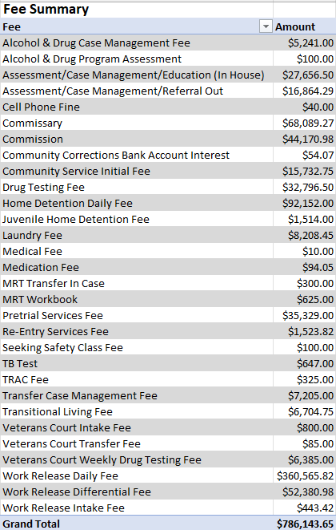
2023 User Fee Income
Whitley County Community Corrections Project Income Fund

Slide 31
As a reminder, the reason previous years prior to 2022 are not included above is because I was tracking commissary by fiscal year (Jul-Jun) instead of the now calendar year (Jan-Dec). Income is calculated from the weekly ledger amounts provided by the Staff processing the money. Expenses are calculated from purchases from Walmart, Amazon, Keefe, and Maxima Supply. Losses are calculated from various means (facility uses, expired product, etc.) The biggest contributor to our losses are typically through "gifting" the $15 certificates to Participants from Staff through actions that Participant's provide to the program or facility. The 2nd biggest contributor (at least for 2022) was facility use (window blinds) prior to a facility audit/walkthrough. Lockers are straight profit (amount is included in the PROFIT total) and since it has to be tracked, it provides a easy way to show data on how much is made. Submitted by: Chad Buzzard, Residential Shift Supervisor

Slide 32
Community Corrections 2023 Review
Whitley County Community Corrections continued to provide levels of supervision that reduced the amount of time offenders serve in jail or the Department of Correction. In addition, Community Corrections provided programming and services to address criminogenic needs. The number of participants struggling with mental health and/or substance abuse disorders continue to be of concern as well as the need for transitional housing and support services for those released from community supervision.
2024 projects include working with the Facility Committee to develop a Community Corrections Facility Building Plan, review staffing plan and make recommendations to respond to current need within justice system and expand transitional housing opportunities.
I continue to be grateful to the staff, community stakeholders, and elected officials for their support and willingness to explore new programming and services that may improve overall health and safety within the community.
Respectfully,
Paula Worden

